Slide 1




GREAT
CANADIAN
DISASTER
Empowering Canada’s continuity professionals to build around resilient nation

Slide 2
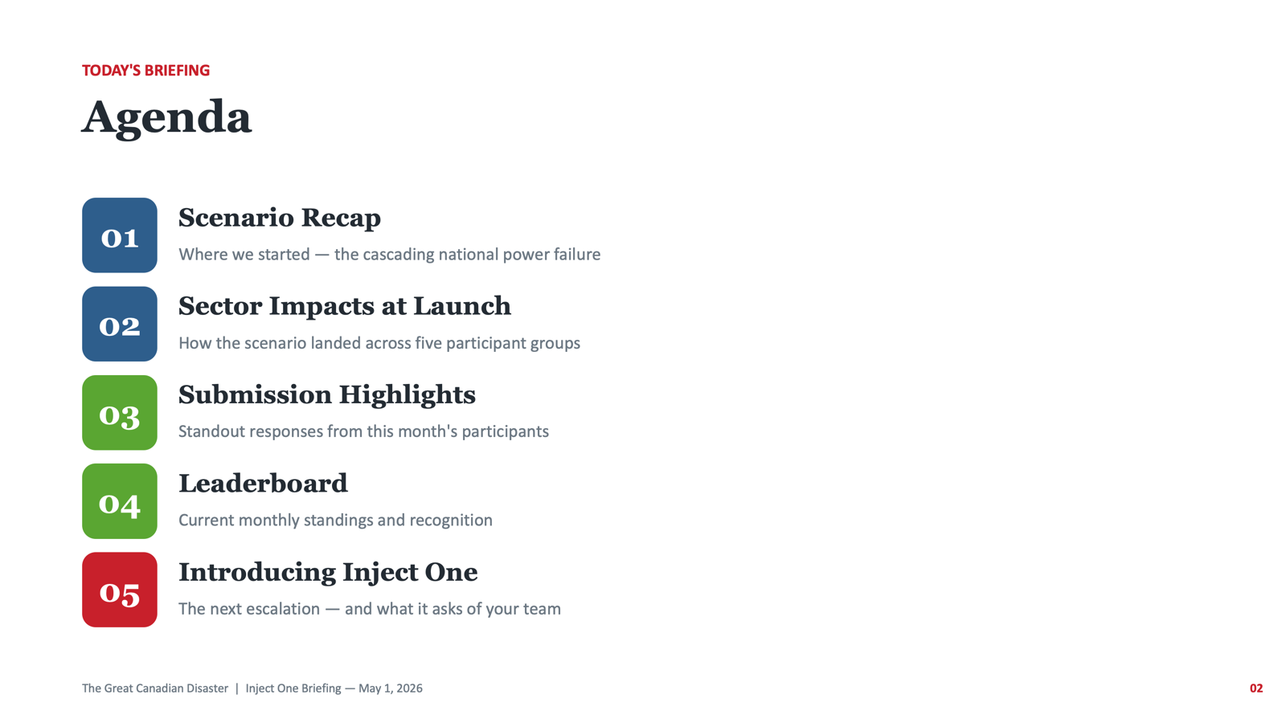

Slide 3
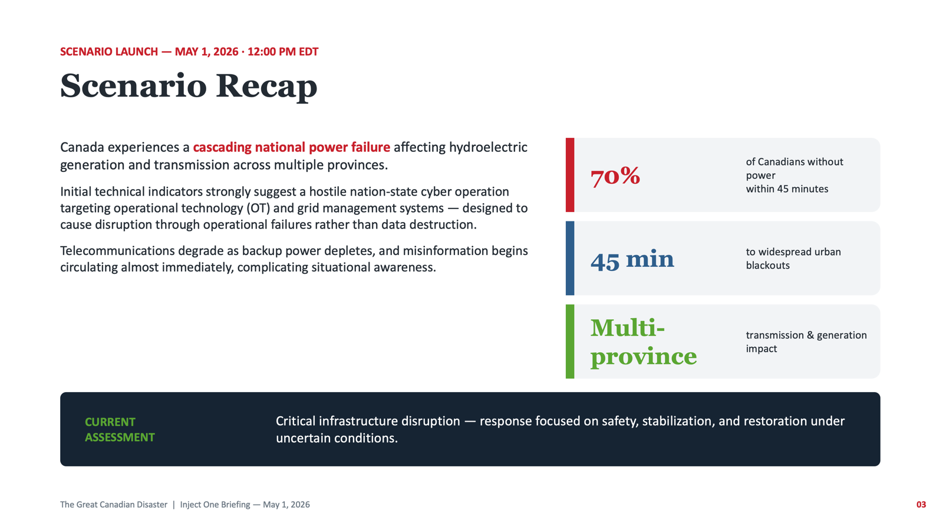

Slide 4
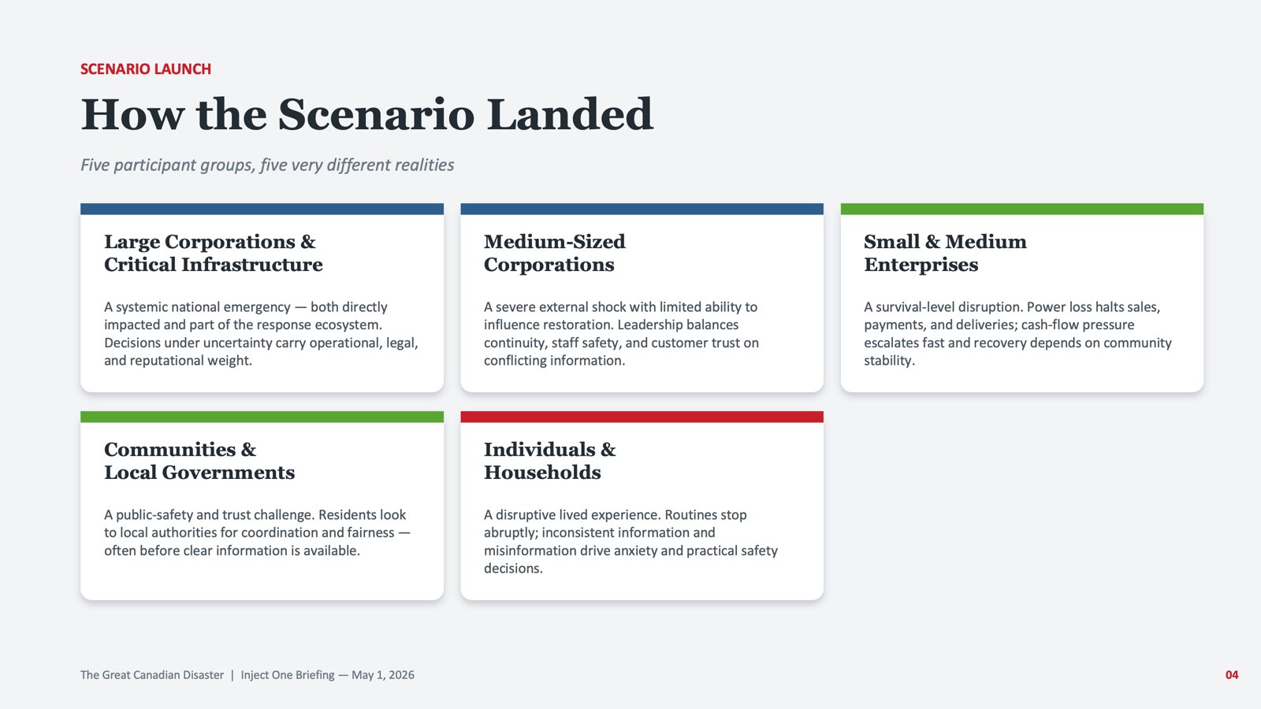

Slide 5
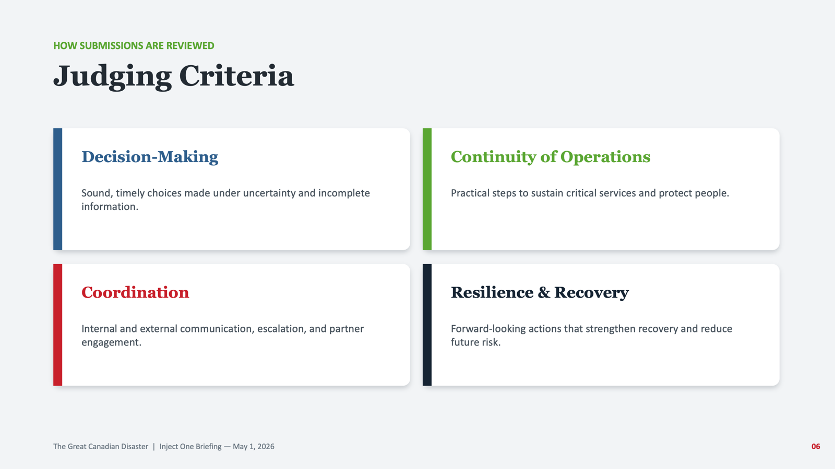

Slide 6
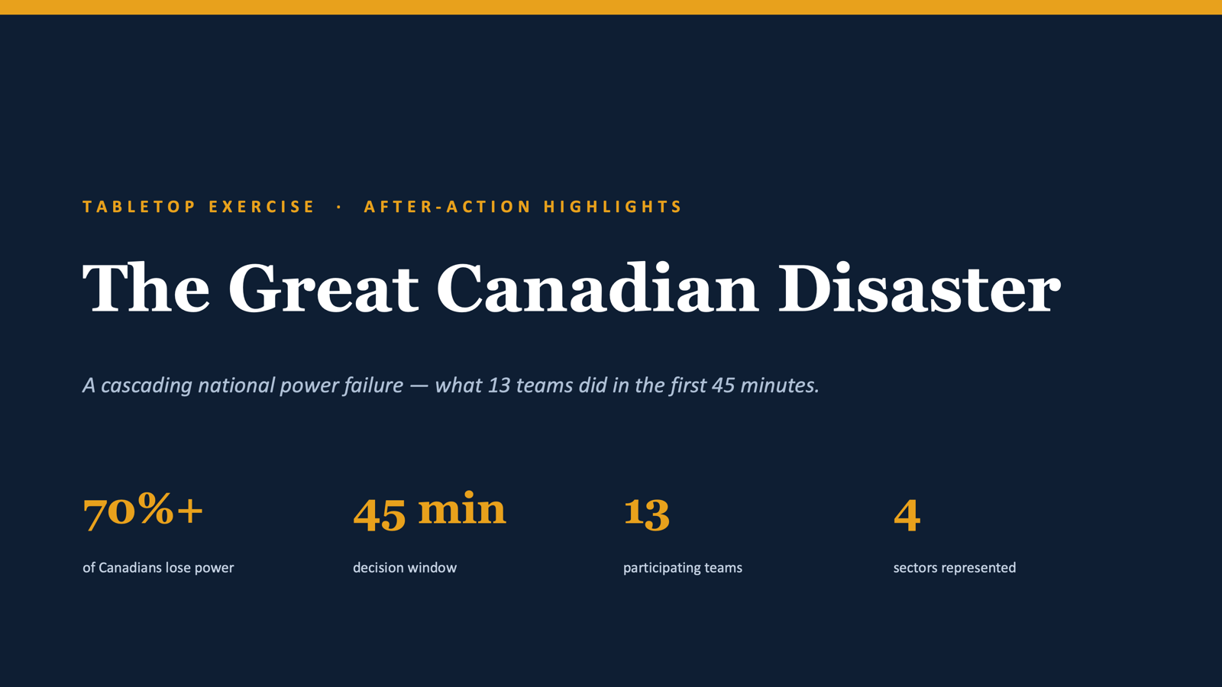

Slide 7
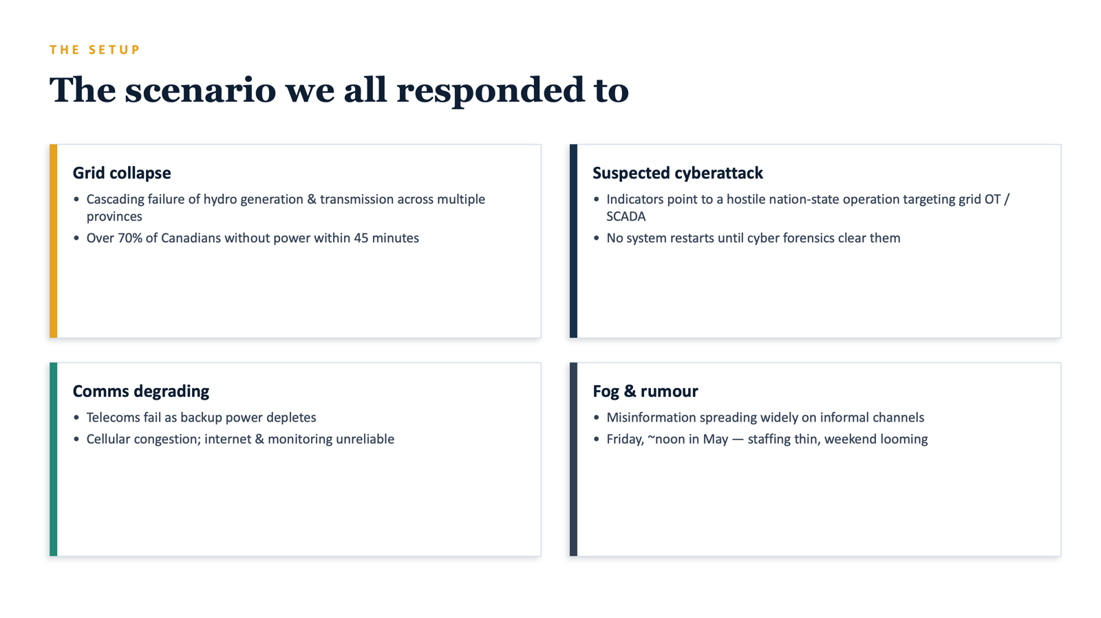

Slide 8
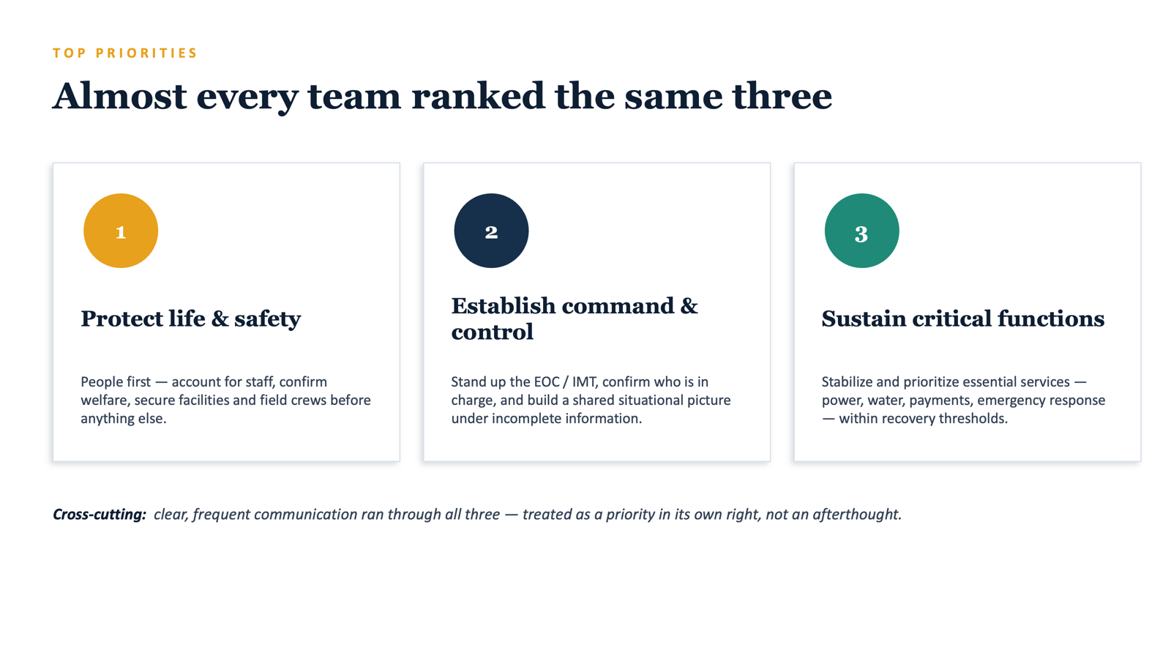

Slide 9
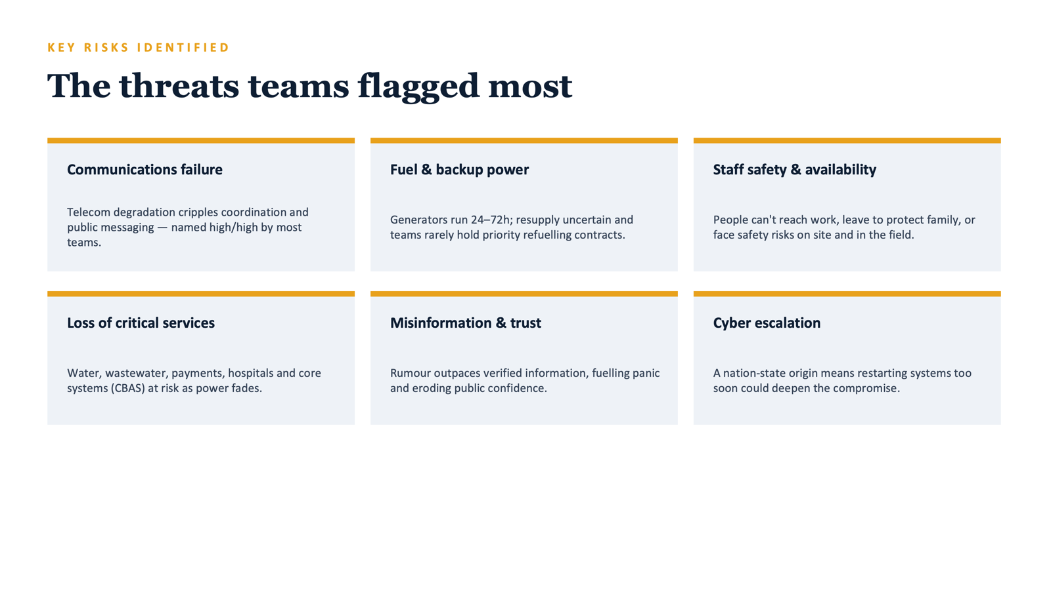

Slide 10
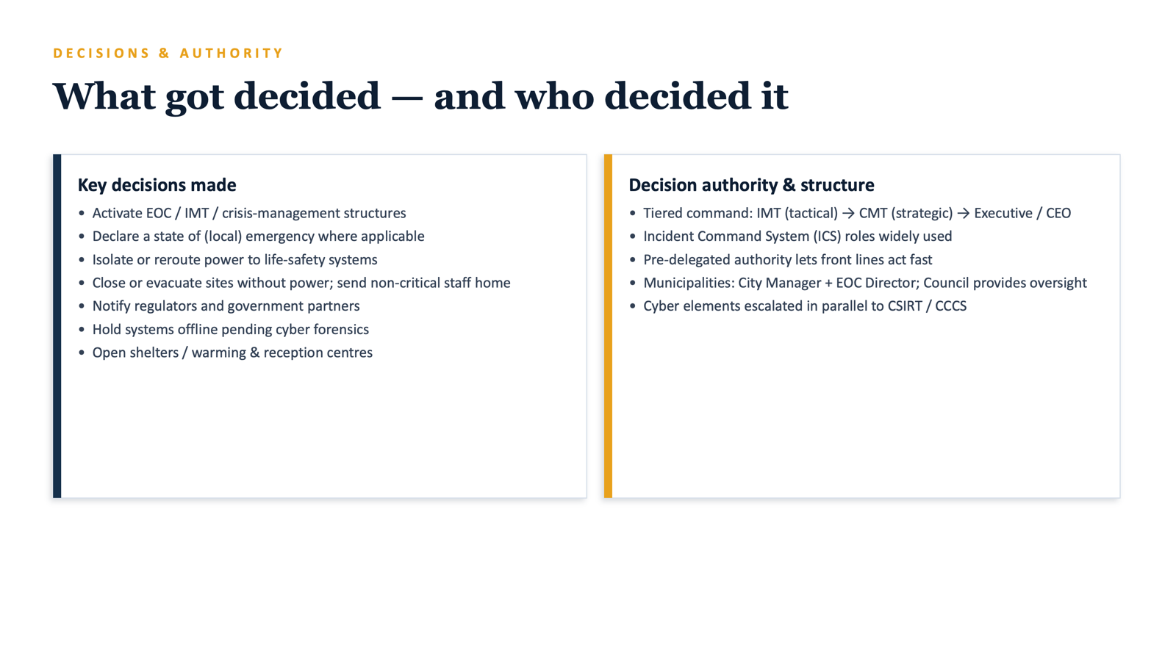

Slide 11
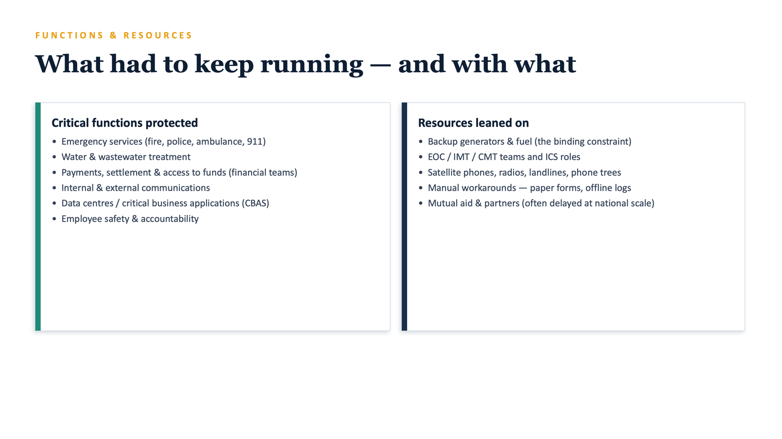

Slide 12
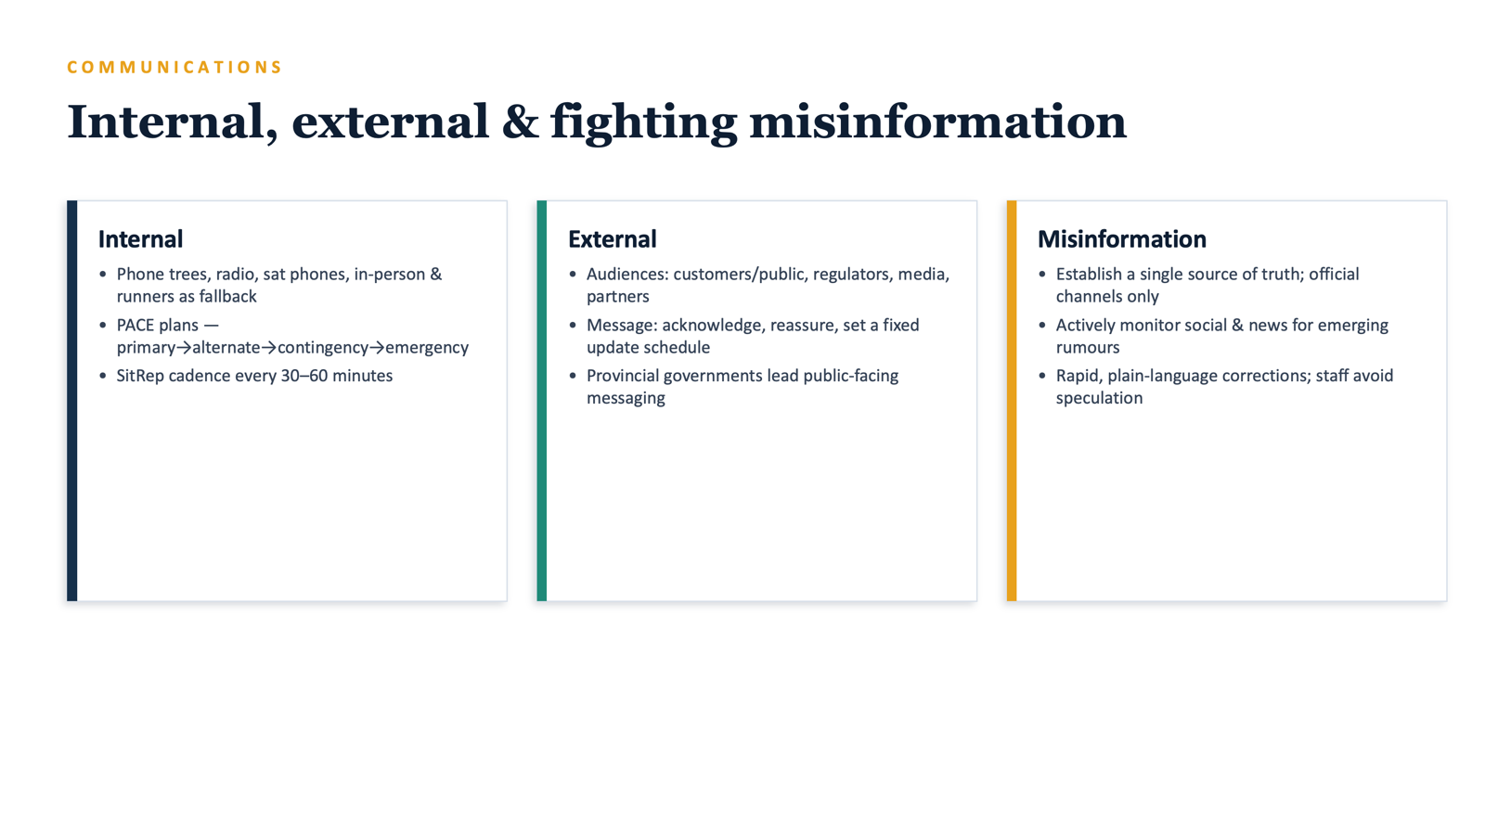

Slide 13
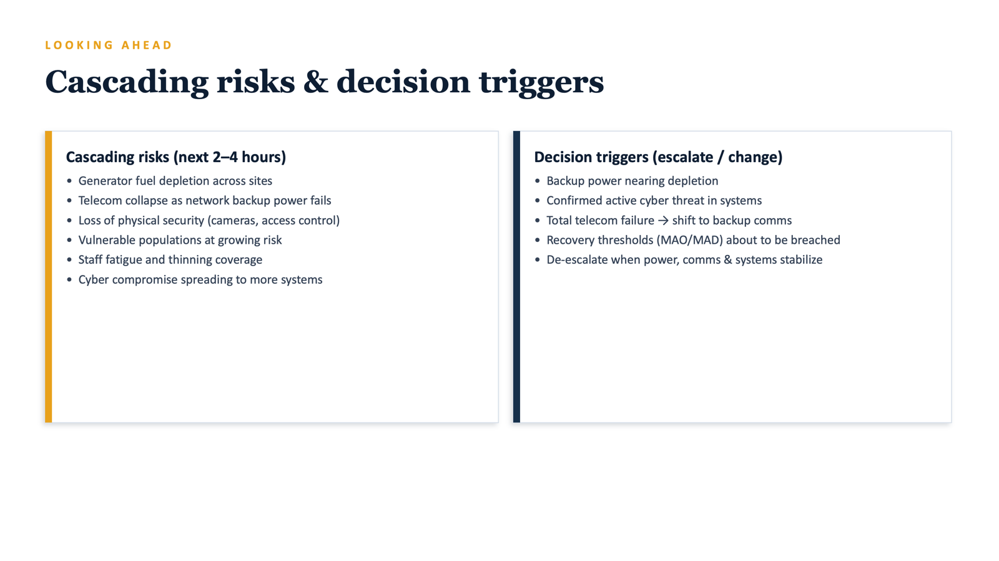

Slide 14
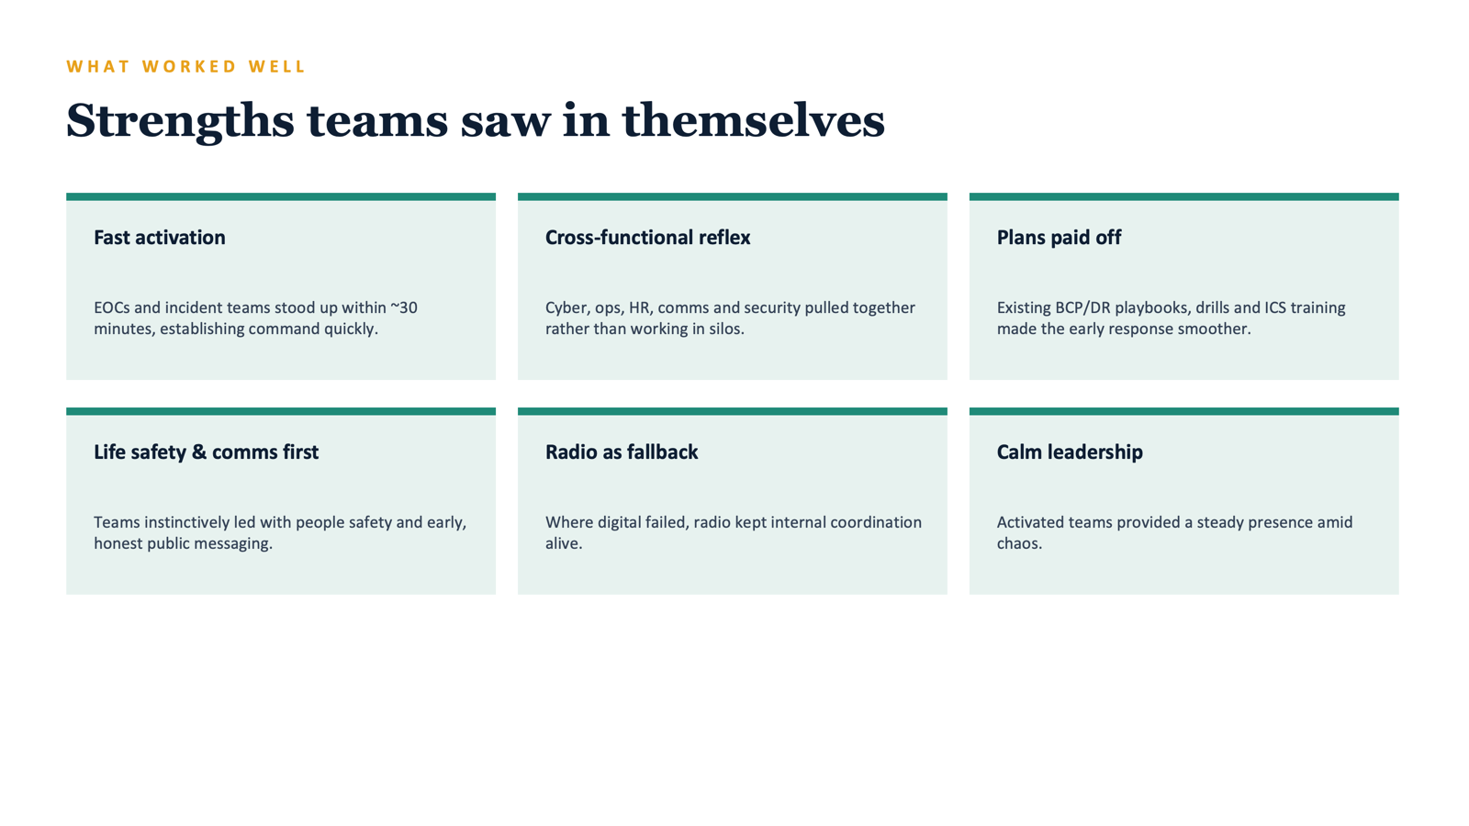

Slide 15
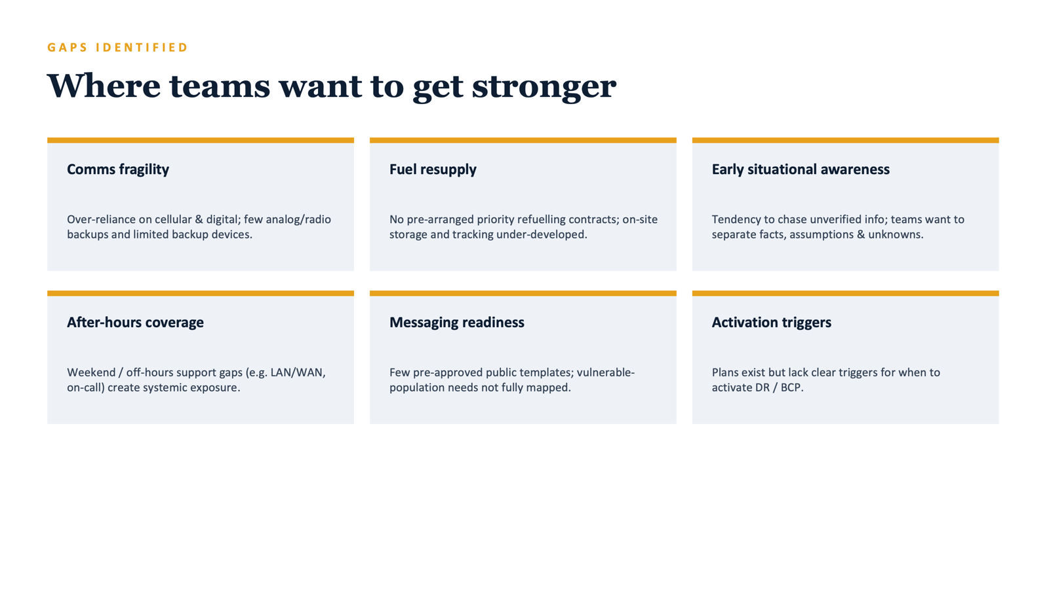

Slide 16
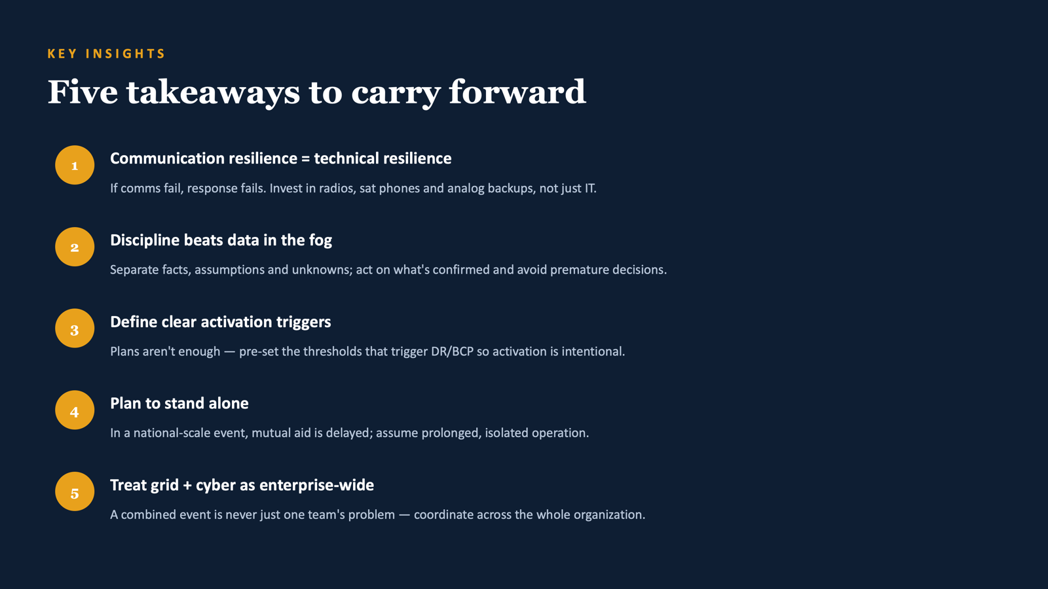

Slide 17


Slide 18
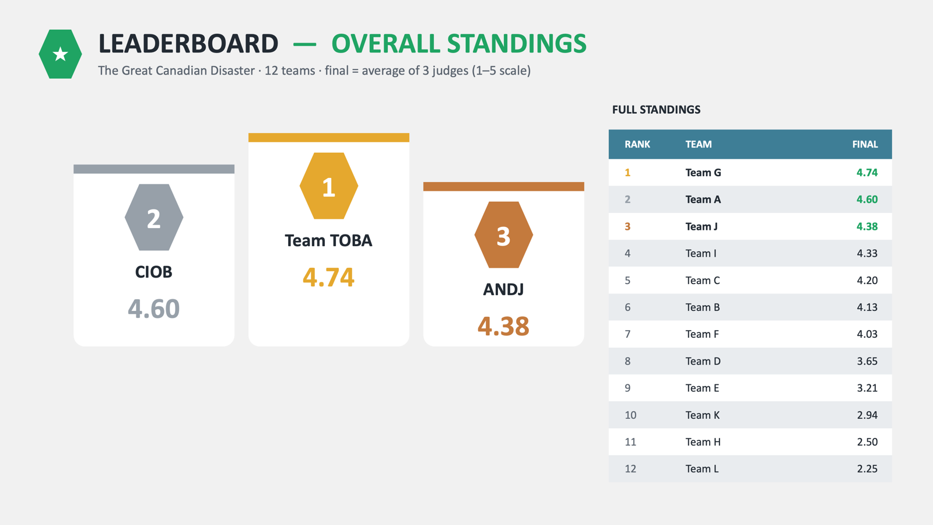

Slide 19
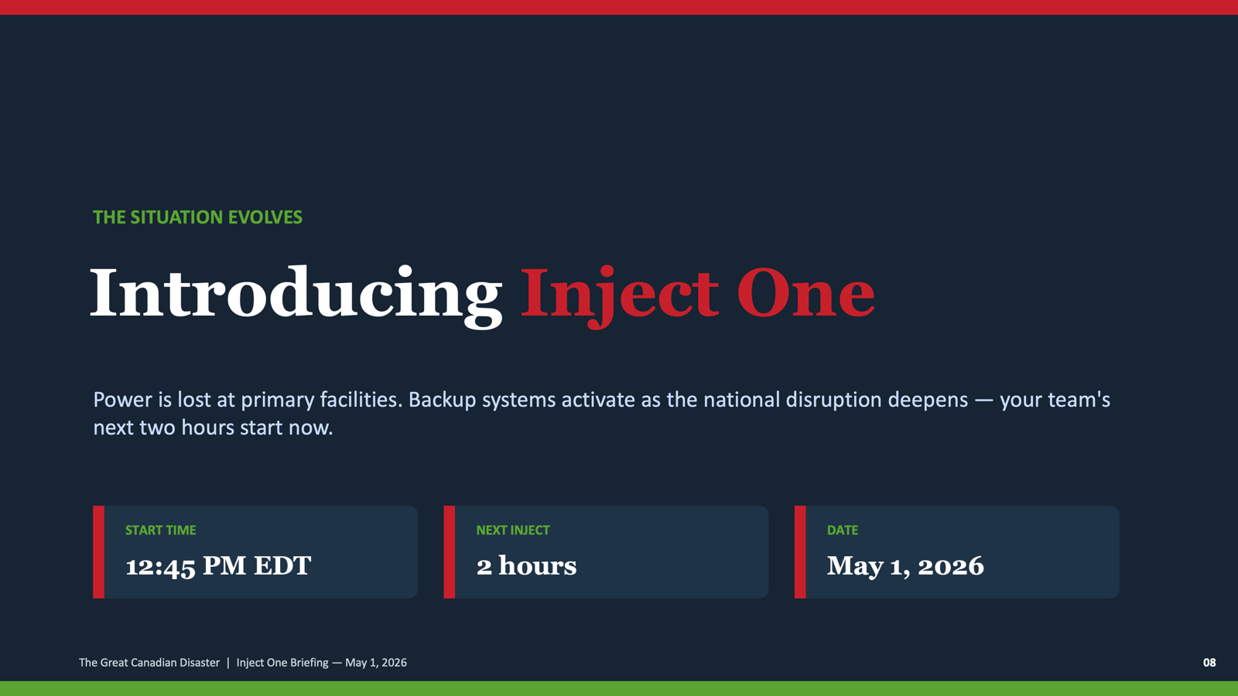

Slide 20
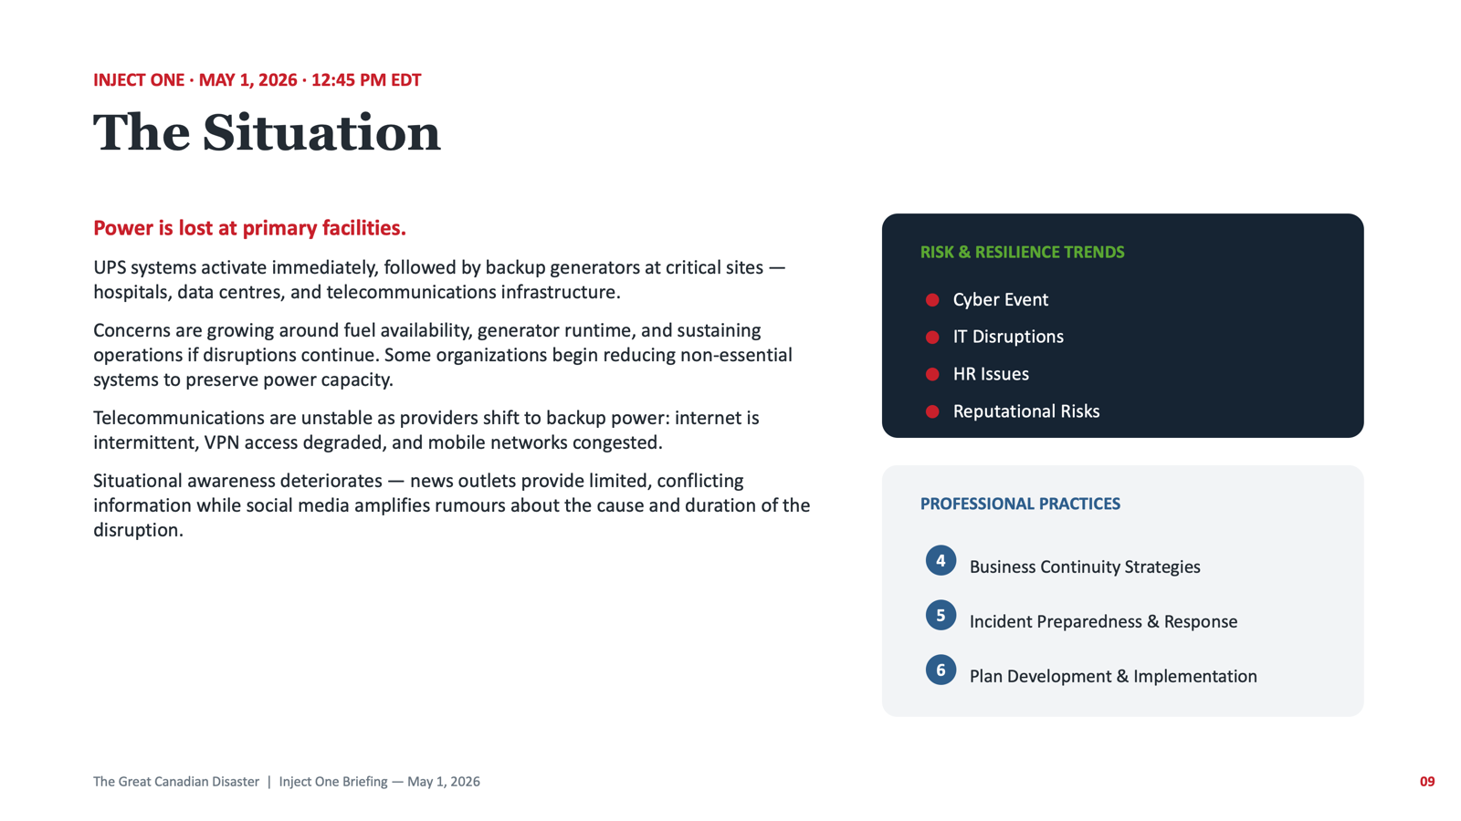

Slide 21
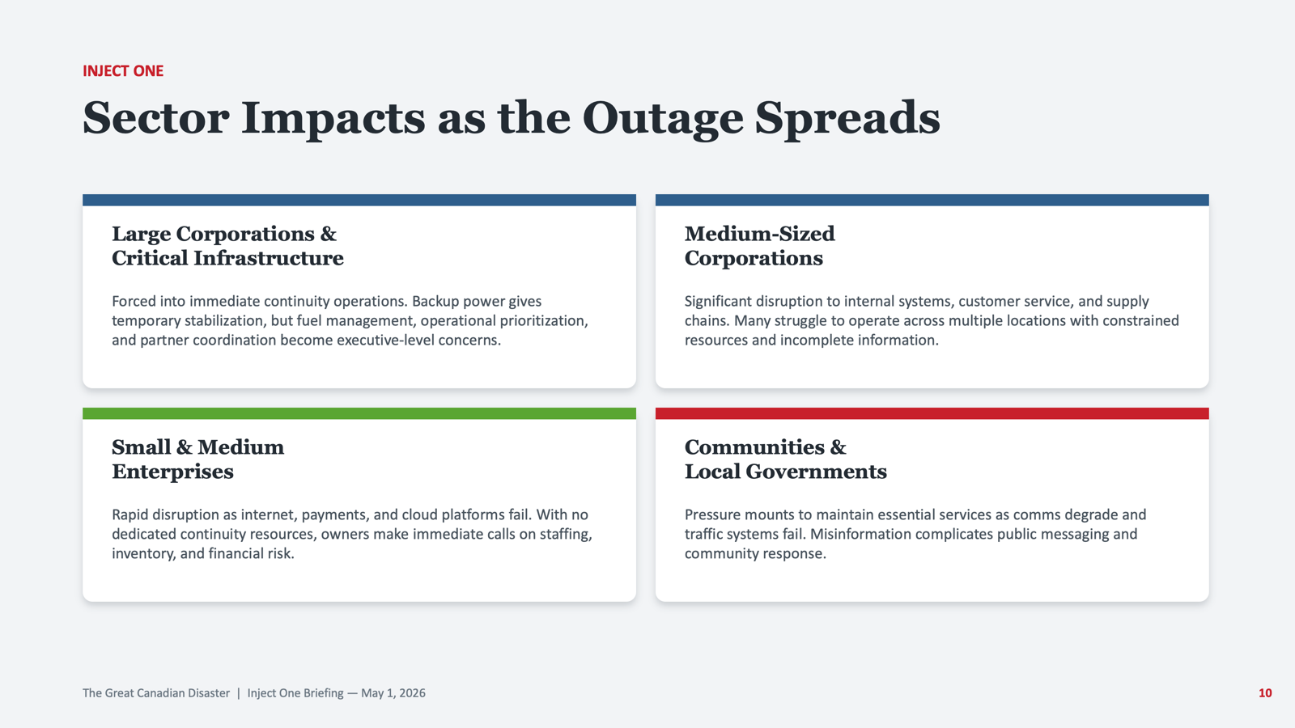

Slide 22
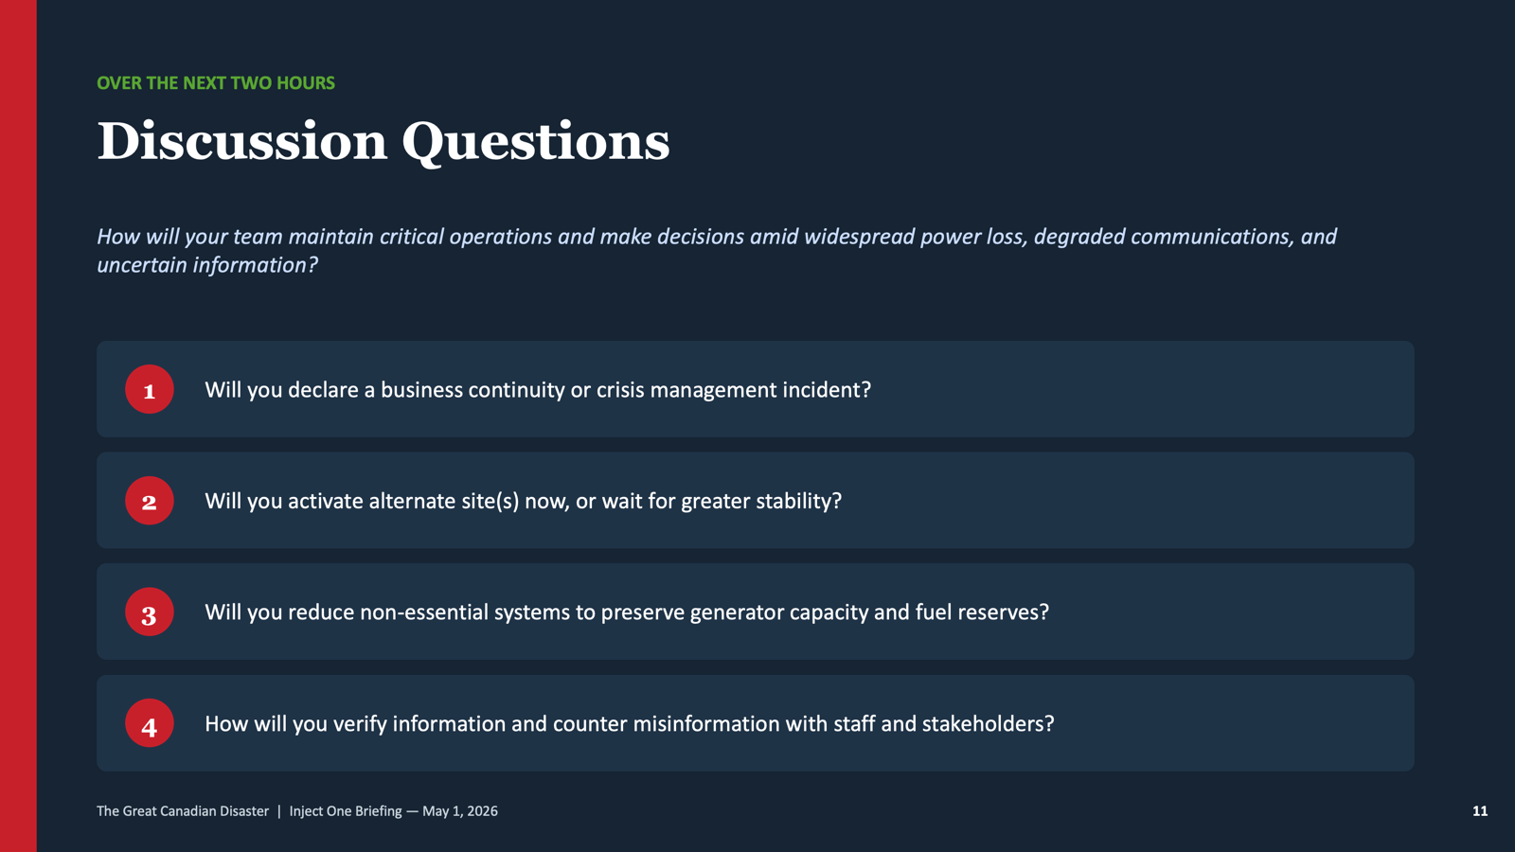

Slide 23
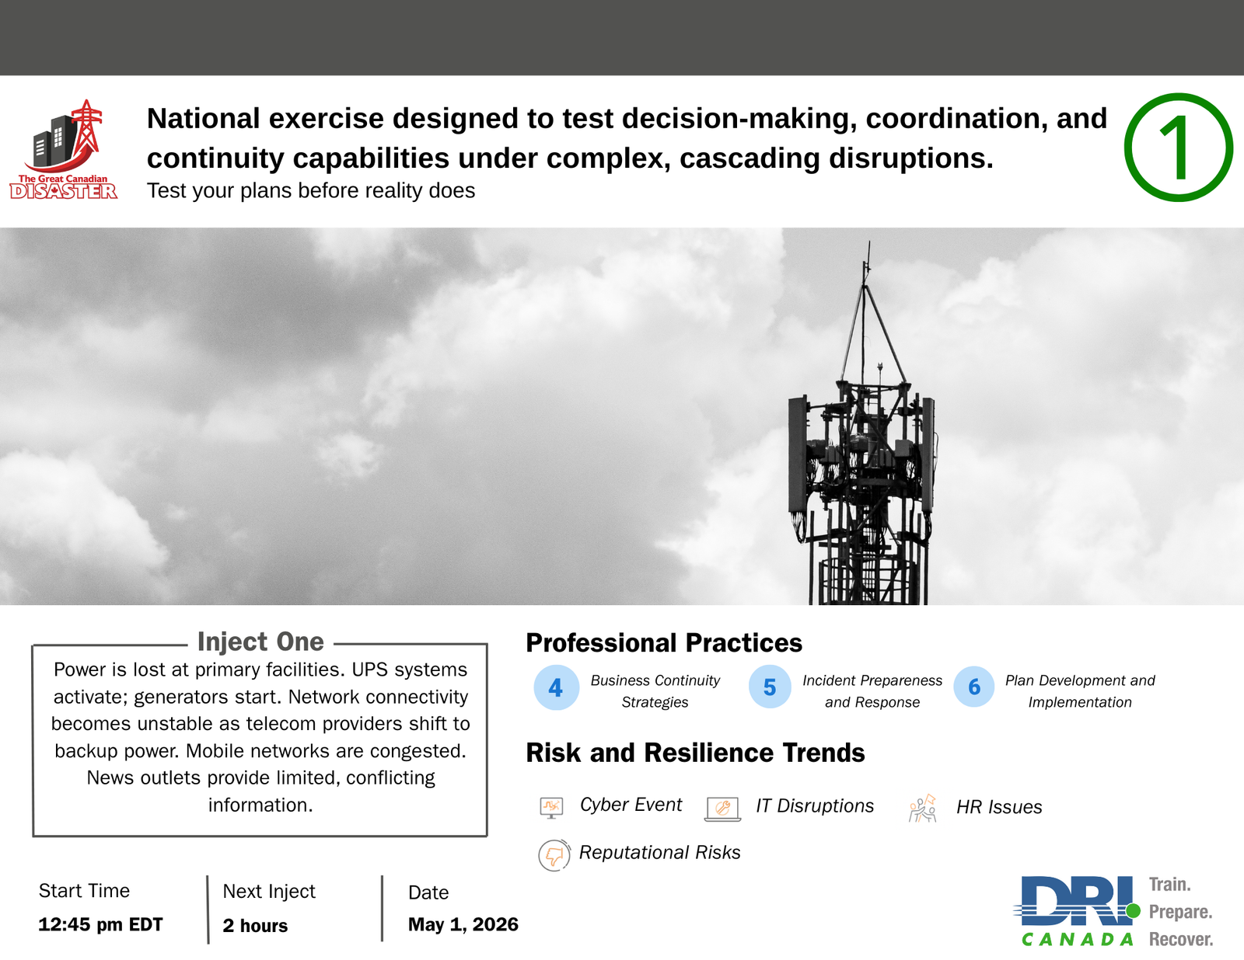

Slide 24
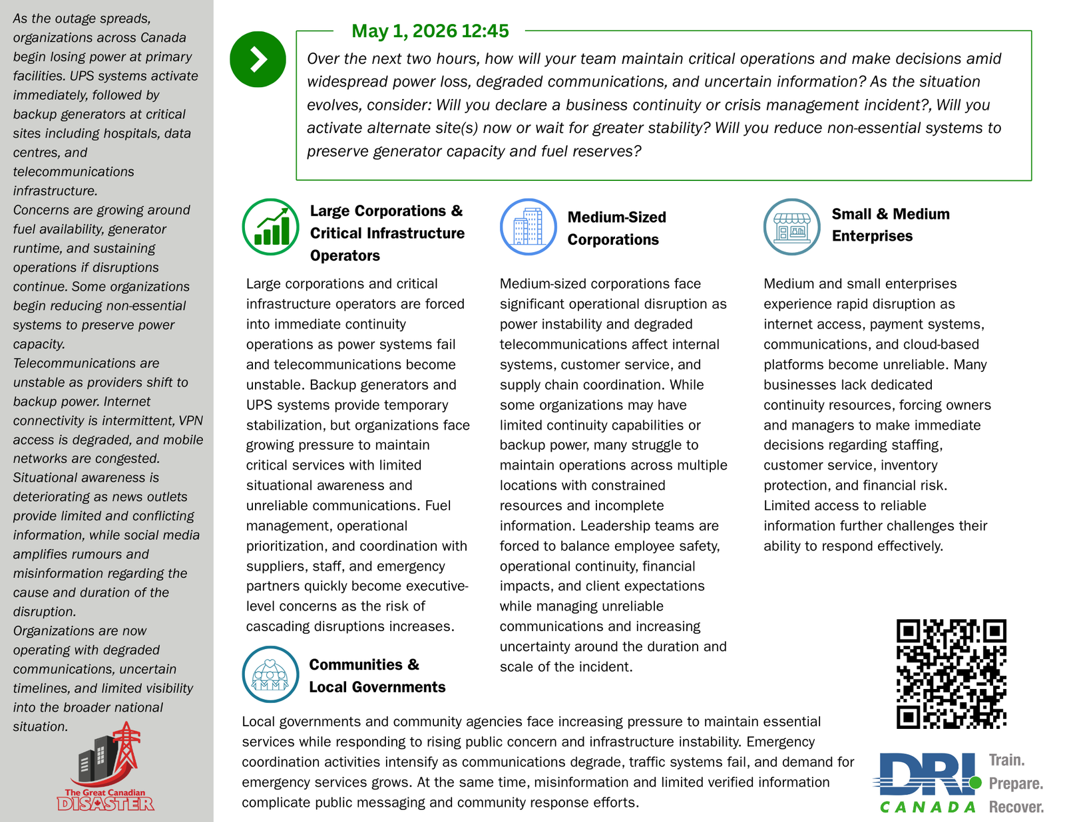

Slide 25



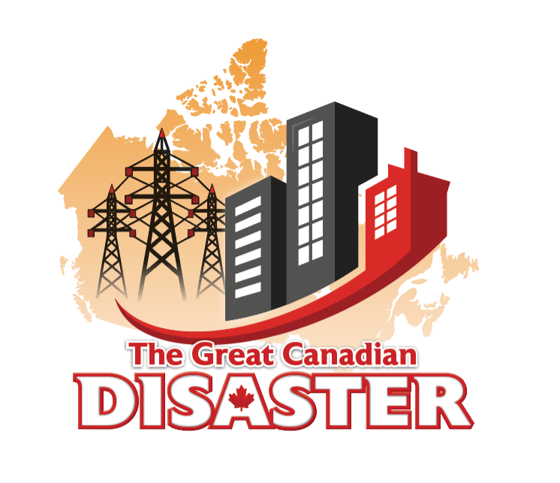

FRIDAY
May 1, 2026
THE GREAT CANADIAN DISASTER
12:45 pm
ADD YOUR LOGO NAME HERE

Slide 26



Large Corporations &
Critical Infrastructure Operators
Large corporations and critical infrastructure operators are forced into immediate continuity operations as power systems fail and telecommunications become unstable. Backup generators and UPS systems provide temporary stabilization, but organizations face growing pressure to maintain critical services with limited situational awareness and unreliable communications. Fuel management, operational prioritization, and coordination with suppliers, staff, and emergency partners quickly become executive-level concerns as the risk of cascading disruptions increases.

Slide 27


Medium-Sized Corporations
Medium-sized corporations face significant operational disruption as power instability and degraded telecommunications affect internal systems, customer service, and supply chain coordination. While some organizations may have limited continuity capabilities or backup power, many struggle to maintain operations across multiple locations with constrained resources and incomplete information. Leadership teams are forced to balance employee safety, operational continuity, financial impacts, and client expectations while managing unreliable communications and increasing uncertainty around the duration and scale of the incident.

Slide 28


Small & Medium Enterprises
Medium and small enterprises experience rapid disruption as internet access, payment systems, communications, and cloud-based platforms become unreliable. Many businesses lack dedicated continuity resources, forcing owners and managers to make immediate decisions regarding staffing, customer service, inventory protection, and financial risk. Limited access to reliable information further challenges their ability to respond effectively.

Slide 29


Communities & Local Governments
Local governments and community agencies face increasing pressure to maintain essential services while responding to rising public concern and infrastructure instability. Emergency coordination activities intensify as communications degrade, traffic systems fail, and demand for emergency services grows. At the same time, misinformation and limited verified information complicate public messaging and community response efforts.

Slide 30

Scenario
Inject 1
Over the next two hours, how will your team maintain critical operations and make decisions amid widespread power loss, degraded communications, and uncertain information? As the situation evolves, consider: Will you declare a business continuity or crisis management incident?, Will you activate alternate site(s) now or wait for greater stability? Will you reduce non-essential systems to preserve generator capacity and fuel reserves?

Slide 31
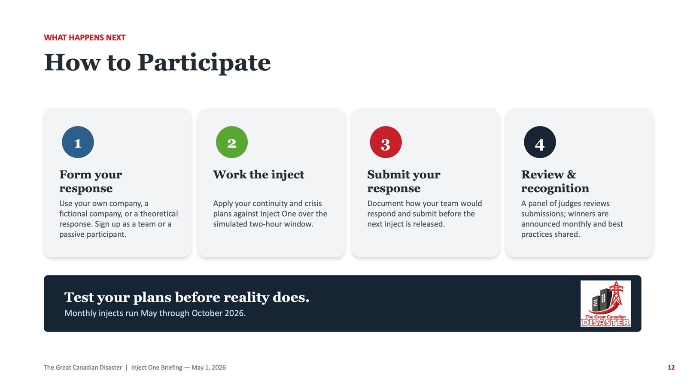

Slide 32
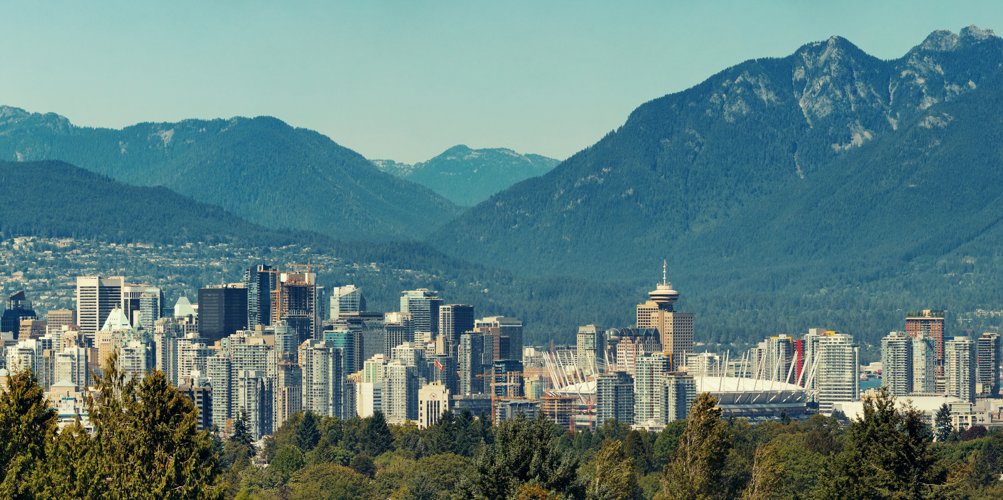

GREAT
CANADIAN
DISASTER
Empowering Canada’s continuity professionals to build around resilient nation

